Slide 1


2026 Impact Plan
Helping single moms take care of the essentials.
Because when the essentials are covered, moms and their children can breathe easier.
Briana Medard
Founder

Slide 2


Our Mission
Supporting single moms in every way
At Plenteemore, we are committed to bringing single moms real moments of relief exactly where it matters most, giving them one less thing to worry about and a chance to breathe a little easier, even if only for a day. We believe that every act of support is a seed, a seed of hope, stability, and possibility. And while our help meets practical needs in the moment, our deeper purpose is to plant seeds that grow into stronger families and eventually into a new generation of moms and children who remember what it felt like to be supported and choose to reach back and strengthen their own communities one day.

Slide 3

The Problem
• Grocery prices continue to rise
• Gas remains unstable
• Utility bills are increasing across Florida
• School and childcare costs strain already-tight budgets
• Economic uncertainty makes it harder to plan
• Most families today have little to no emergency cushion
The World Right Now
Families are struggling more than ever. Groceries, gas, utilities, childcare, everything has gone up. And single mothers are being hit the hardest.

Slide 4
The Data
A Quantified Look at the Crisis
• Nearly 1 in 3 households in Florida are led by single mothers
• 40%+ of single-mom households cannot meet basic needs
• Food costs are up 20%+ in the last 2 years
• Utility costs in Florida have risen 10–15%
• Many single moms spend 30–50% of income on housing alone
• Gas in South Florida consistently exceeds the national average
Families are struggling more than ever. Groceries, gas, utilities, childcare, everything has gone up. And single mothers are being hit the hardest.

Slide 5
Why This Matters
At the end of the day, the essentials matter.
They’re what keep a mom and her children going.
They’re what stabilize a home.
They’re what bring relief — even if just for a moment.
For single moms, the rising cost of groceries, gas, utilities, and school needs means every dollar gets stretched.
One unexpected bill can change everything.
One spike in utilities can mean choosing between gas and groceries.
One tough month can create a ripple that affects the whole household.
When the essentials are covered, a family can finally breathe — even if just for today.

Slide 6

The Heart Behind
Plenteemore's Founding Inspiration
Briana's journey began with a deep understanding of the struggles single moms face. I grew up watching people step in to help my mom. When they brought groceries, paid a bill, or helped us get through a hard moment, our whole home felt the relief.
Plenteemore exists to be that same help for other families.

Slide 7




The Evolution of Plenteemore
2023
2024
2025
2026+
We began by rewarding kindness in the community, giving $500+ away in prizes.
Took a break to reevaluate our purpose
We shifted to supporting single moms through various monthly initiatives.
Plenteemore 2.0 focuses on essentials-driven impact and serving families at scale.

Slide 8
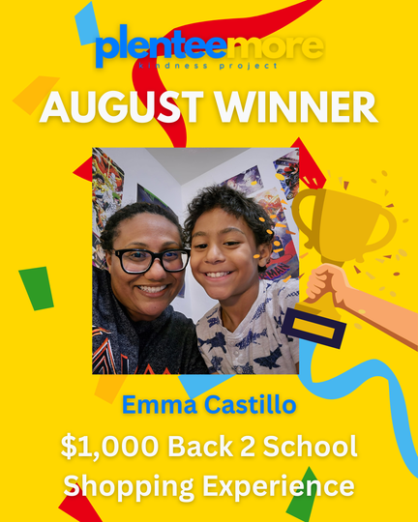



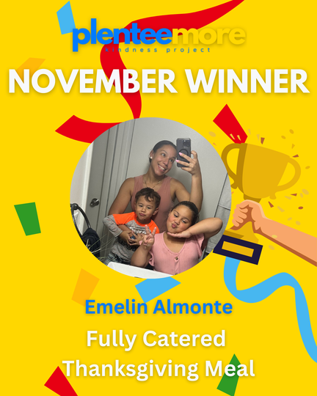

A Look Back at 2025
  Emma received an extra $1,000 surprise check, and it turned out to be right on time. Just two days later, she had an accident and was able to use it to put money down on a new car.
  Glennys Received an additional $100 to enjoy her spa day.
  For Thanksgiving every mother received a bottle of wine with their meal.
  Every mother a receives a special made bouquet of flowers, to make every gift extra special.

Slide 9
Introducing
2.0

Slide 10
A practical, essentials-driven support model designed to bring single moms moments of relief exactly when and where they need it most.
2026 is the year we scale our impact with a clear structure, consistent support, and initiatives that meet real needs for moms and their children across South Florida.
2.0

Slide 11
How Plenteemore Will Serve in 2026
In 2026, we will support single moms through three types of initiatives:
1. Monthly Essentials Initiatives
Each month focuses on one practical need, such as laundry, groceries, utilities, or school readiness. These initiatives deliver real, immediate relief.
2. Quarterly Community Initiatives
Wine Down Wednesday sessions that offer connection, rest, and mental wellness support for moms.
3. Year Round Essentials Support
Gas Card Fridays, providing weekly fuel support for moms who need help getting to work, getting their kids to school, and staying on the move.
This structure allows us to support families consistently while protecting sustainability, capacity, and quality of care.
2026 Support Structure Overview
The Essentials That Matter Most

Slide 12
Monthly
Initiatives
Overview
Each month features one focused initiative that tackles a core essential. These include:
• Laundry
• Groceries and household items
• Utility support
• Back to school
• Thanksgiving Meal Delivery
• Birthday celebrations for families
• Other seasonal needs
Every initiative is designed to give moms one less thing to worry about and help families breathe a little easier.
The Essentials That Matter Most

Slide 13

January 2026
Laundry Day
Laundry Day helps families wash and dry their clothes at no cost, easing one of the most expensive weekly essentials for moms without in-home machines. This gives moms real relief and helps their families start the year with clean clothes and one less financial burden.
What We Cover
• Washing and drying cycles for each family
• One full size detergent for every household
• Light breakfast and refreshments for moms and children
Goal
Serve 15 families.
Estimated Cost
$2K
Notes
With additional funding, we hope to host a second Laundry Day later in the year. A second cycle would bring the total estimated cost to $4K.

Slide 14


March 2026
Essentials Box
The Essentials Box program provides families with a generous mix of groceries, pantry staples, toiletries, and household items. Each box is designed to ease daily pressure and help moms stretch their budget a little further. All boxes are packed and delivered directly to families so the support feels warm, personal, and dignifying.
What We Provide
• Groceries and pantry staples
• Toiletries for everyday use (soap, toothpaste, lotion)
• Household items and cleaning supplies (dish soap, cleaning spray, wipes)
• Paper goods (paper towels or toilet paper)
• Delivery to each home
Goal
Serve 15 families
Estimated Cost
$3K
Sponsorship Insight
Each Essentials Box is valued at approximately $100.
Sponsors may choose to fund one family, several families, or the full initiative.

Slide 15

May 2026
Utilities Support
Helping single moms stay on top of essential bills by providing direct support toward one active or past due utility account. This will help prevent service interruptions, reduce financial pressure, and give families a little more breathing room.
What We Provide
• Direct payment toward one utility bill (electric, water, internet, or phone)
• Up to $200 per family
• Payments are made directly to the provider on behalf of the family
Goal
Support 15 families
Estimated Cost
$3k (15 families × $200 each)
Note
With additional funding, we hope to host a second cycle in October. A second cycle would bring the cost to approximately $6K.

Slide 16


July 2026
Back-to-School Shopping
Back-to-school season is one of the most expensive times of the year for single moms. We take moms and their children on a full back-to-school outing, covering the costs, handling transportation, and creating a meaningful moment of relief and joy.This experience gives moms a break from that financial pressure and allows their children to start the school year feeling prepared, confident, and cared for.
What We Provide
• A $1,000 shopping for clothes, shoes, backpacks, and school supplies
• Transportation so moms don’t have to worry about gas or logistics
• Lunch for the family during the outing
• A $200 surprise gift per family to help with additional expenses or savings
Goal
Support 5 families
Estimated Cost
$6k USD

Slide 17

August 2026
Birthday Bash
Plenteemore will host a joyful celebration for children with birthdays in August, creating cherished memories through cake, games, and community fun, uniting families in shared happiness. Each child brings their mom and siblings for a free, fun day designed to create memories without financial stress.
What We Provide
  Venue
  Food trucks
  Kid-friendly entertainment (face painting, games, DJ, etc.)
  Gift bags for the birthday children
  Goodie bags for all kids in attendance
Goal
Celebrate 10 children with a cost-free birthday experience for their families.
Estimated Cost
$2.5K

Slide 18

November 2026
Thanksgiving
Meal Delivery
We prepare and deliver fully cooked Thanksgiving meals directly to 15 families so families can enjoy the holiday at home without the financial or emotional pressure. These meals give families comfort, joy, and a meaningful sense of relief during one of the most expensive times of the year.
What We Provide
• Fully cooked Thanksgiving dinner for a family (entrée, sides, bread)
• Beverages
• A bouquet of flowers for each mom
• A bottle of wine for each mom
• Trays and packaging
• Direct doorstep delivery
Goal
Serve 15 families.
Estimated Cost
$3K

Slide 19
Quaterly
Initiatives
Overview
Each month features one focused initiative that tackles a core essential. These include:
• Laundry
• Groceries and household items
• Utility support
• Back to school
• Holiday essentials
• Birthday celebrations for families
• Other seasonal needs
Every initiative is designed to give moms one less thing to worry about and help families breathe a little easier.
The Essentials That Matter Most

Slide 20

April, September, December
2026
Wine Down Wednesdays
Wine Down Wednesday is a quarterly gathering where single moms can unwind, connect, and reset. These evenings offer a relaxed environment with food, wine, conversation, and small wellness moments that help moms breathe a little easier.
What We Provide
• Venue
• Light bites and refreshments
• Wine (donated when possible)
• Wellness experiences
Goal
Host 3 gatherings
Estimated Cost
$2K per event
(Covers food, supplies, and wellness activities; venue and wine often donated)

Slide 21
Weekly
Initiatives
Overview
Each month features one focused initiative that tackles a core essential. These include:
• Laundry
• Groceries and household items
• Utility support
• Back to school
• Holiday essentials
• Birthday celebrations for families
• Other seasonal needs
Every initiative is designed to give moms one less thing to worry about and help families breathe a little easier.
The Essentials That Matter Most

Slide 22

Weekly
Gift Card Fridays
Gift Card Fridays provide weekly essentials support so moms can take care of everyday needs like getting to work, school drop-offs, appointments, and keeping food in the house. This small weekly relief helps keep families moving.
What We Provide
$50 gift cards every Friday
Goal
Provide $50 gift cards every week of 2026
Minimum impact: support 52–104 moms throughout the year.
Estimated Cost
$2,600 (1 mom weekly)
$5,200 (2 moms weekly)
Note
The more funding we have, the more gas cards we can giveaway

Slide 23
Additional Support Funds
Each month features one focused initiative that tackles a core essential. These include:
• Laundry
• Groceries and household items
• Utility support
• Back to school
• Holiday essentials
• Birthday celebrations for families
• Other seasonal needs
Every initiative is designed to give moms one less thing to worry about and help families breathe a little easier.
The Essentials That Matter Most

Slide 24
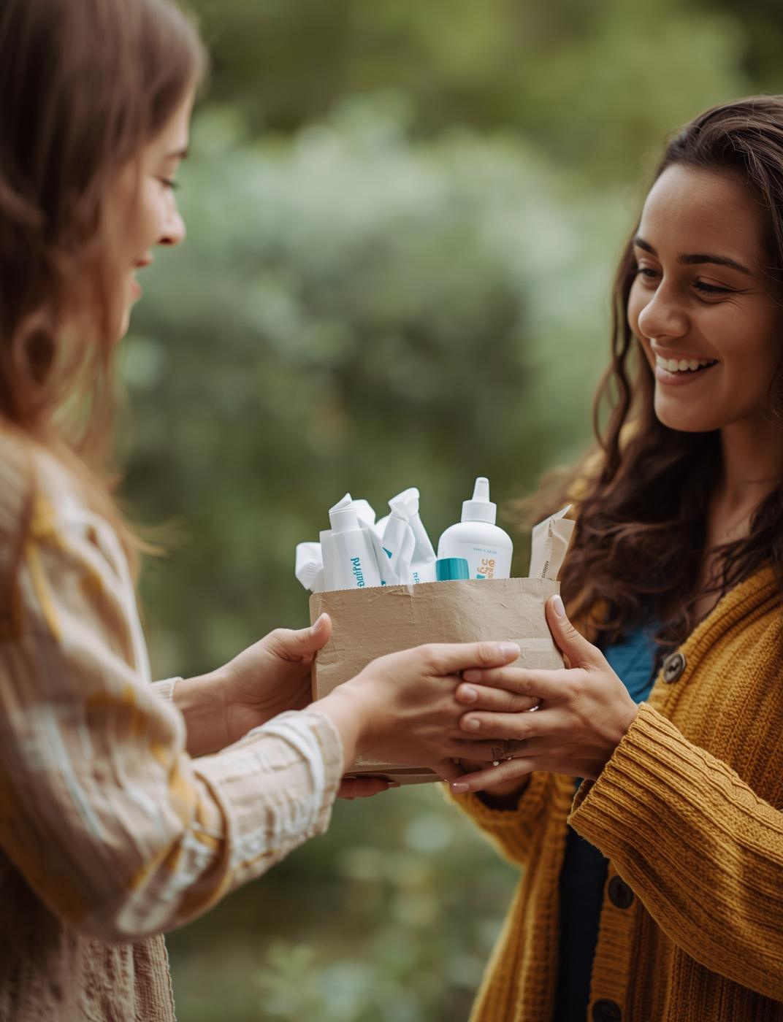
Essentials Fund
The Essentials Fund helps us meet everyday needs that fall outside of our monthly programs.
When a mom reaches out with an unexpected expense — groceries, diapers, a small bill, a last-minute need — this fund lets us step in immediately and offer support.
What It Supports
• Small grocery assistance
• Urgent household needs
• Transportation or meal help
• Supplemental support during initiatives
• Operational essentials that keep Plenteemore running
Goal
Maintain a flexible fund that keeps Plenteemore responsive, reliable, and able to show up for moms in real time.
Estimated Annual Need
$3K

Slide 25

JOY Fund
The JOY Fund is dedicated to moments that go above and beyond — special experiences that honor, uplift, and surprise moms who rarely receive anything for themselves.
What It Supports
• Spa days
• Home cleanings
• Family outings
• Personal surprises
• Experience-based blessings throughout the year
Goal
Create meaningful moments of joy for moms who need reminders that they matter too.
Estimated Annual Need
$3K

Slide 26
How You
Can Be
A Part of
This Work…
Each month features one focused initiative that tackles a core essential. These include:
• Laundry
• Groceries and household items
• Utility support
• Back to school
• Holiday essentials
• Birthday celebrations for families
• Other seasonal needs
Every initiative is designed to give moms one less thing to worry about and help families breathe a little easier.
The Essentials That Matter Most

Slide 27
How You Can Help
Sponsor an Initiative
Sponsor a Family
In-Kind Support
Fund a monthly, quarterly, or annual initiative.
(Examples: Laundry Day, Essentials Box, Utility Support, Wine Down Wednesday, Holiday Meals)
Cover a set number of families for any initiative:
Laundry Day, Essentials Boxes, Utility Support, Back-to-School, or Thanksgiving Meals.
Provide goods or services that reduce program costs (food, venues, gift cards, supplies, wellness experiences, etc.)
Fund a Relief Program
Corporate or Group Giving
Volunteer Engagement
Joining our volunteer team offers you a chance to connect with local families, actively participate in community events, and make a positive impact in the lives of single moms.
Support the Essentials Fund or JOY Fund, which help moms with urgent needs or special moments throughout the year.
Invite your employees, members, or customers to join you in supporting Plenteemore initiatives.

Slide 28

Sponsor Benefits
We keep sponsorship simple and meaningful.
Every sponsor is recognized with gratitude and visibility, and larger supporters can receive enhanced benefits when appropriate.
All Sponsors Receive
• Recognition on the Plenteemore website
• Social media features and sponsor spotlights
• Logo placement on initiative materials (when applicable)
• Inclusion in thank-you posts and recap content
• Impact updates showing how their support made a difference
• Optional presence at sponsored events
Enhanced Benefits (for full-initiative sponsors)
• Highlight reel featuring your brand
• Special feature in Plenteemore’s monthly email update

Slide 29

2026 Budget Overview
Projected funding for essential support
Monthly Initiatives
• Laundry Day: $2,000.00
• Essentials Box: $3,00.00
• Utility Support: $3,000.00
• Back-to-School Shopping: $6,000.00
• Birthday Bash: $2,500.00
• Thanksgiving Meal Delivery: $3,000.00
Quarterly Initiatives
• Wine Down Wednesday (3 events): $6,000.00
Weekly Initiative
• Gas Card Fridays (1–2 moms weekly): $2,600.00–$5,200.00
Year-Round Funds
• Essentials Fund: $3,000.00
• JOY Fund: $3,000.00
Estimated 2026 Funding Range
$39K - $42K

Slide 30
Impact At A Glance
In 2026, Plenteemore will create meaningful moments of relief for single moms by:
Providing direct essentials support all year long
(food, utilities, gas, school needs, laundry)
Supporting families across multiple touchpoints
(home, school, transportation, community, and emotional wellbeing)
Reducing financial strain during the highest-pressure moments of the year
Strengthening community and emotional connection for moms who often do everything alone
Delivering practical support that brings immediate peace, breathing room, and hope
Your partnership doesn’t just fund programs.
It touches real homes, real families, and real moments that matter.

Slide 31

Let's Partner
Join us in making a difference
If you’re ready to partner or have questions, connect with us.
Briana Medard
Founder, Plenteemore
📧 plenteemore@gmail.com
🌐 plenteemore.com
Follow Our Work
Instagram: @plenteemore
Facebook: Plenteemore Kindness Project
TikTok: @plenteemore

